Slide 1
P12 - Cache Design
Ferrari Dario, Mazzeo Andrea

Slide 2
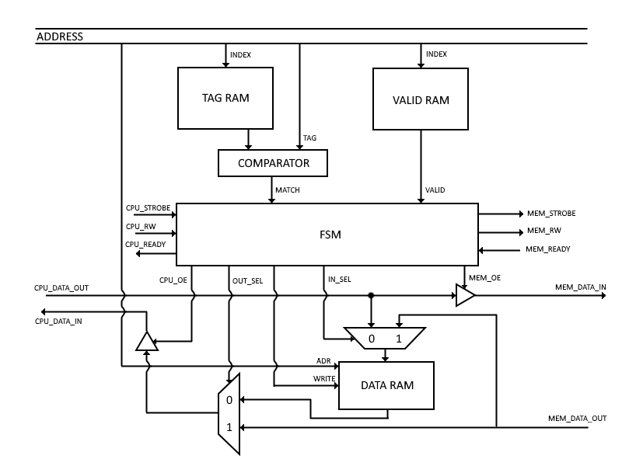
General overview
To be defined:
Associativity
Write policy: - Write through
- Write back
Write miss: - Allocate
- Not allocate
Size

Slide 3
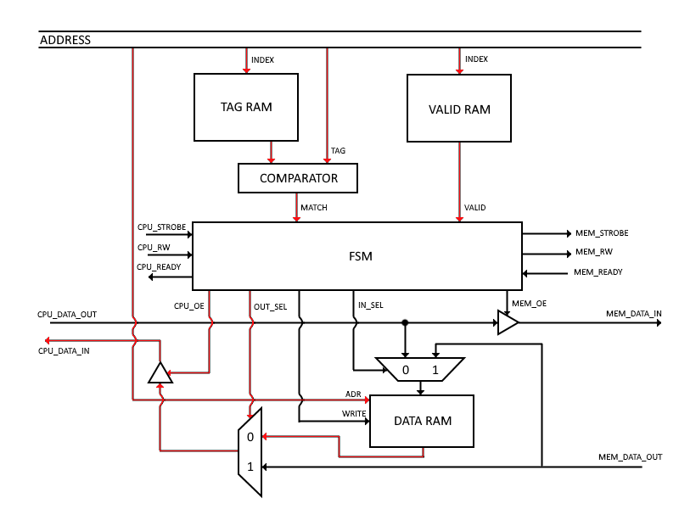
01. Read hit

Slide 4
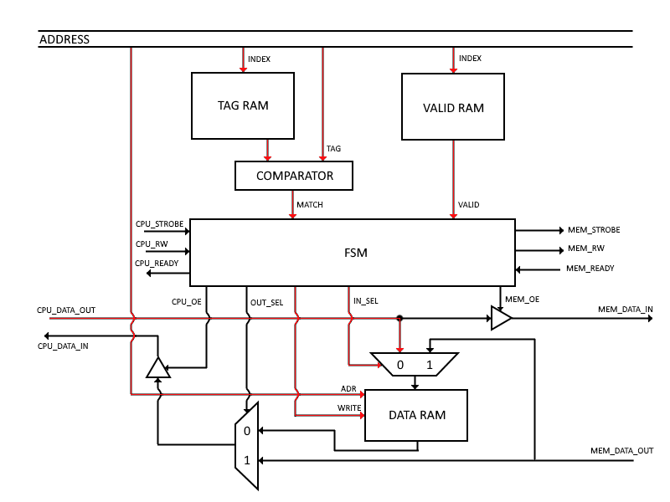
02. Write hit

Slide 5
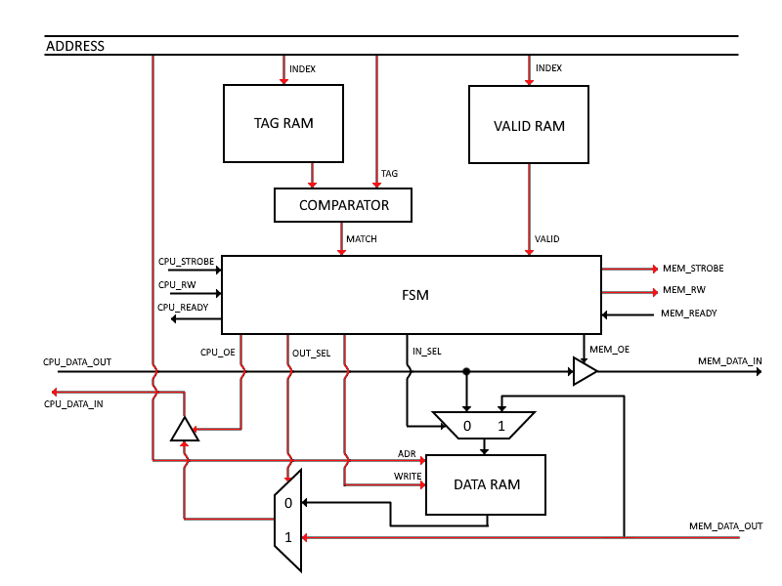
03. Read miss

Slide 6
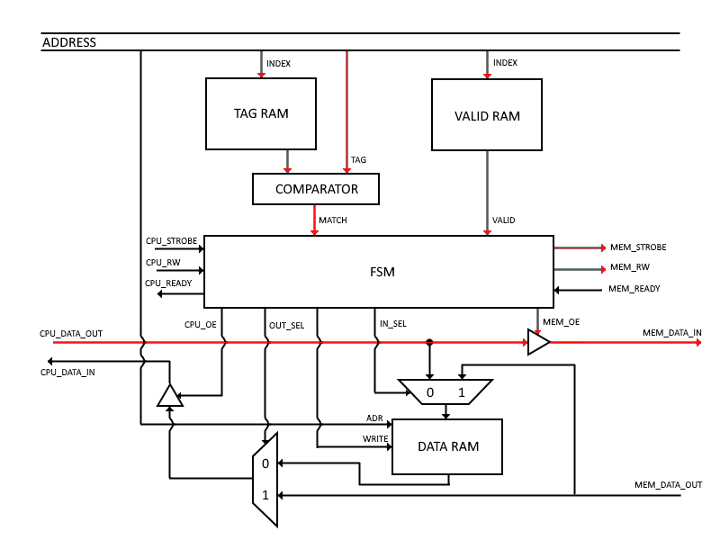
04. Write Miss

Slide 7
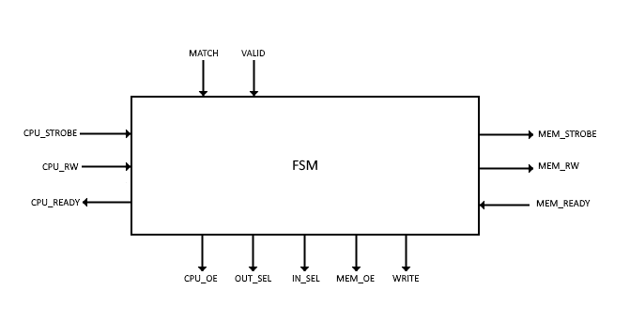
Unit control
Input:
- CPU_STROBE
- CPU_RW
- MATCH
- VALID
- MEM_READY
Output:
- CPU_READY
- MEM_STROBE
- MEM_RW
- CPU_OE
- MEM_OE
- OUT_SEL
- IN_SEL
- WRITE

Slide 8
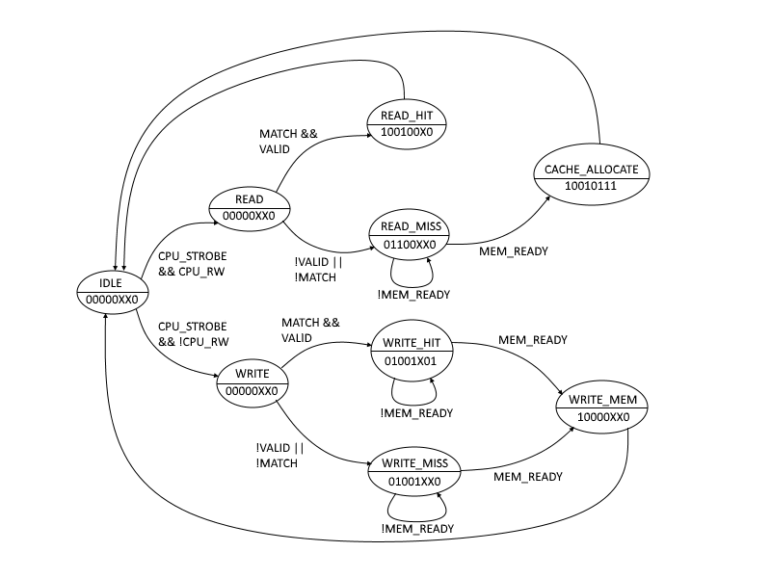
Finite State Machine
1 bit: CPU_READY
2 bit: MEM_STROBE
3 bit: MEM_RW
4 bit: CPU_OE
5 bit: MEM_OE
6 bit: OUT_SEL
7 bit: IN_SEL
8 bit: WRITE

